Slide 1
Customer leads Prediction

Slide 2
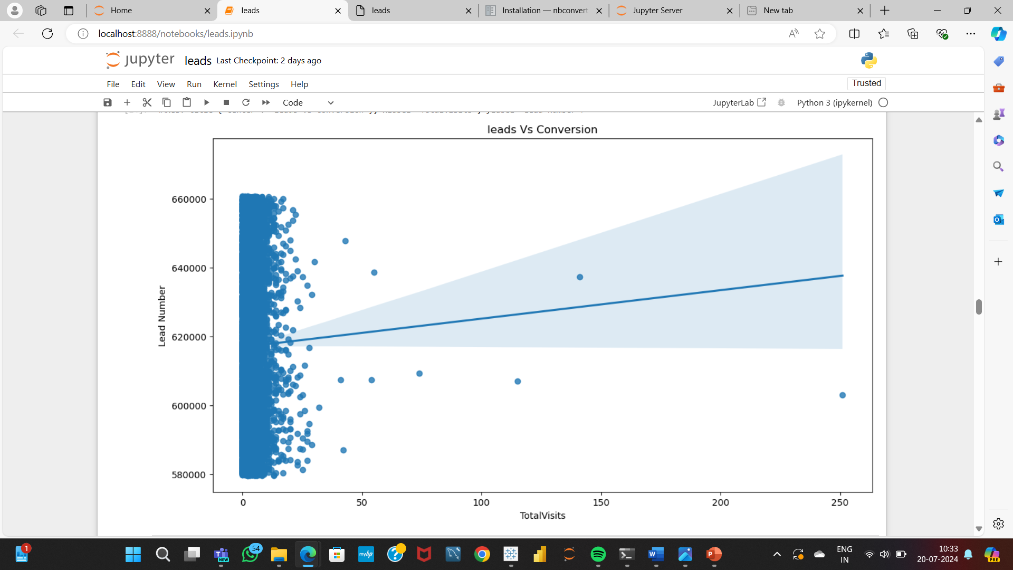
EDA Insight 1
This EDA insight is about the leads and the total visits by the customers
We can see a positive insight as the there is the increase in total visits

Slide 3
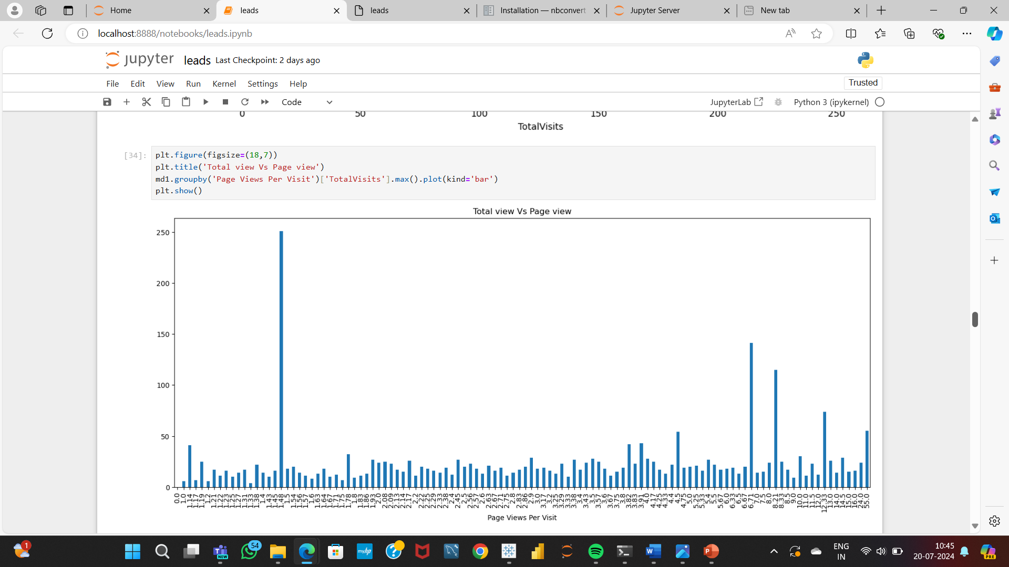
EDA Insight 2
This EDA insight shows the total number of visits across the page view per visit
The total visits and page view per visits are grouped to get the maximum visits

Slide 4
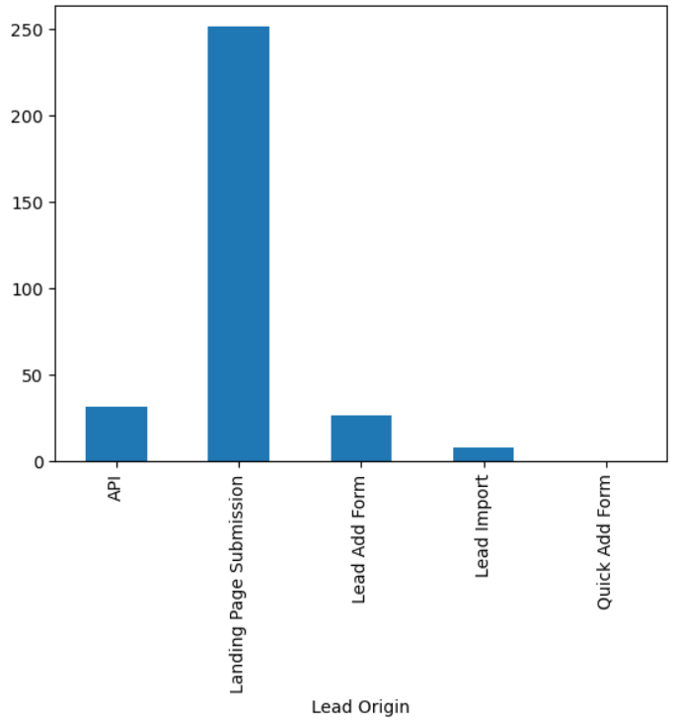
EDA Insight 3
This insight shows the relation between the total visits and the origin of the leads
The maximum lead origin can be found by grouping the total visits and lead origin

Slide 5
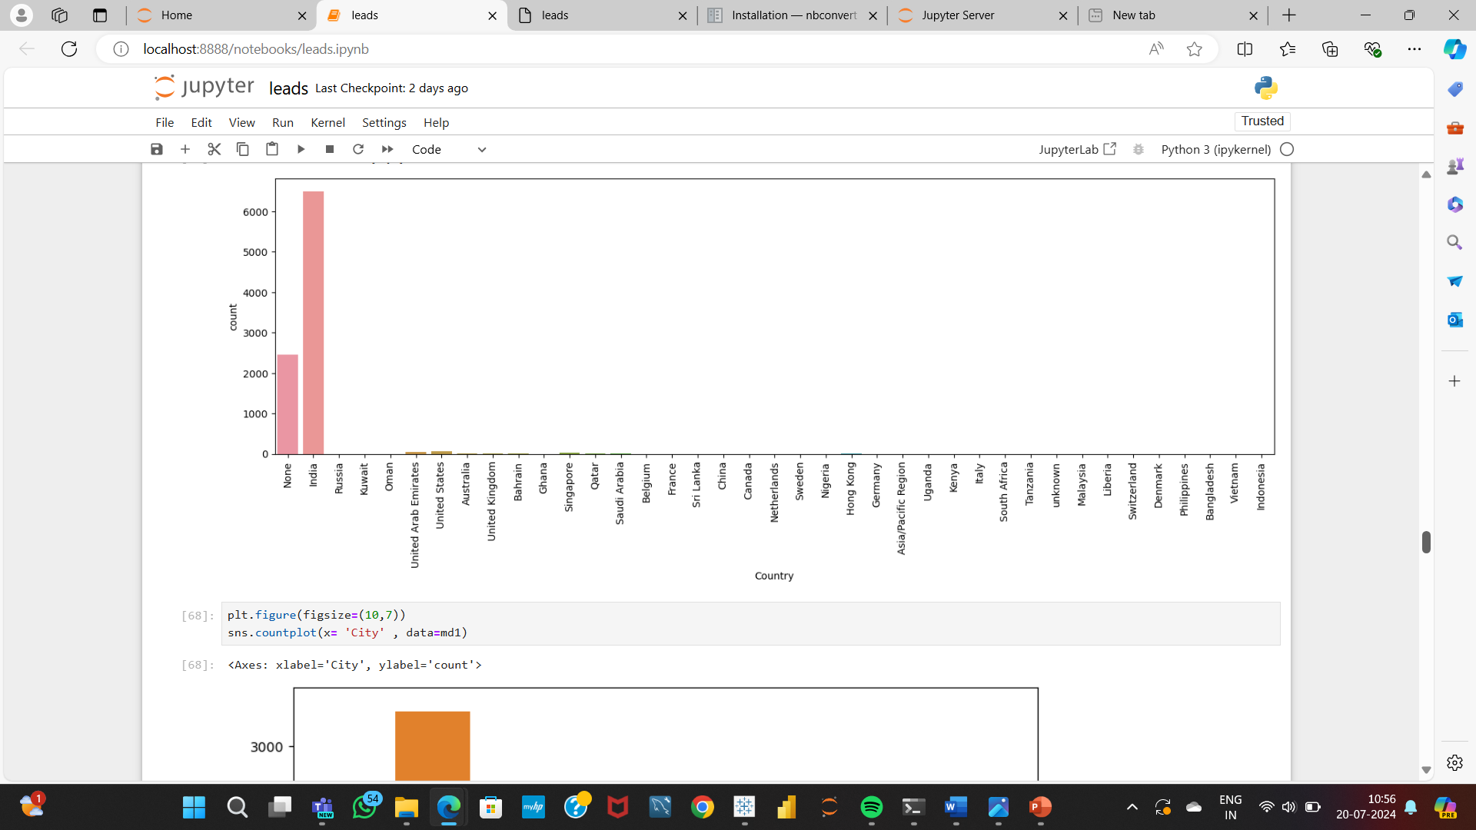
EDA Insight 4
This insight shows the countries which has maximum count of leads

Slide 6
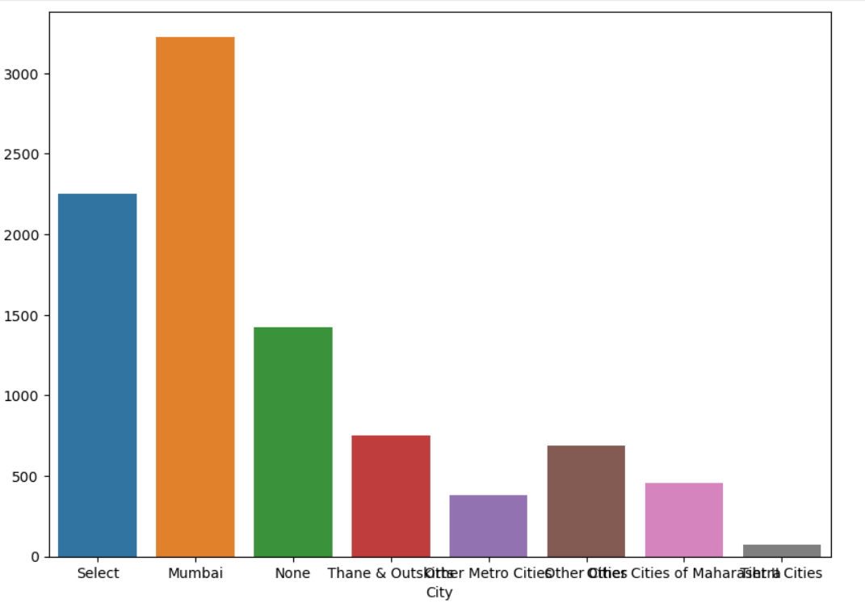
EDA Insight 5
This insight shows the cities having maximum count of leads.

Slide 7
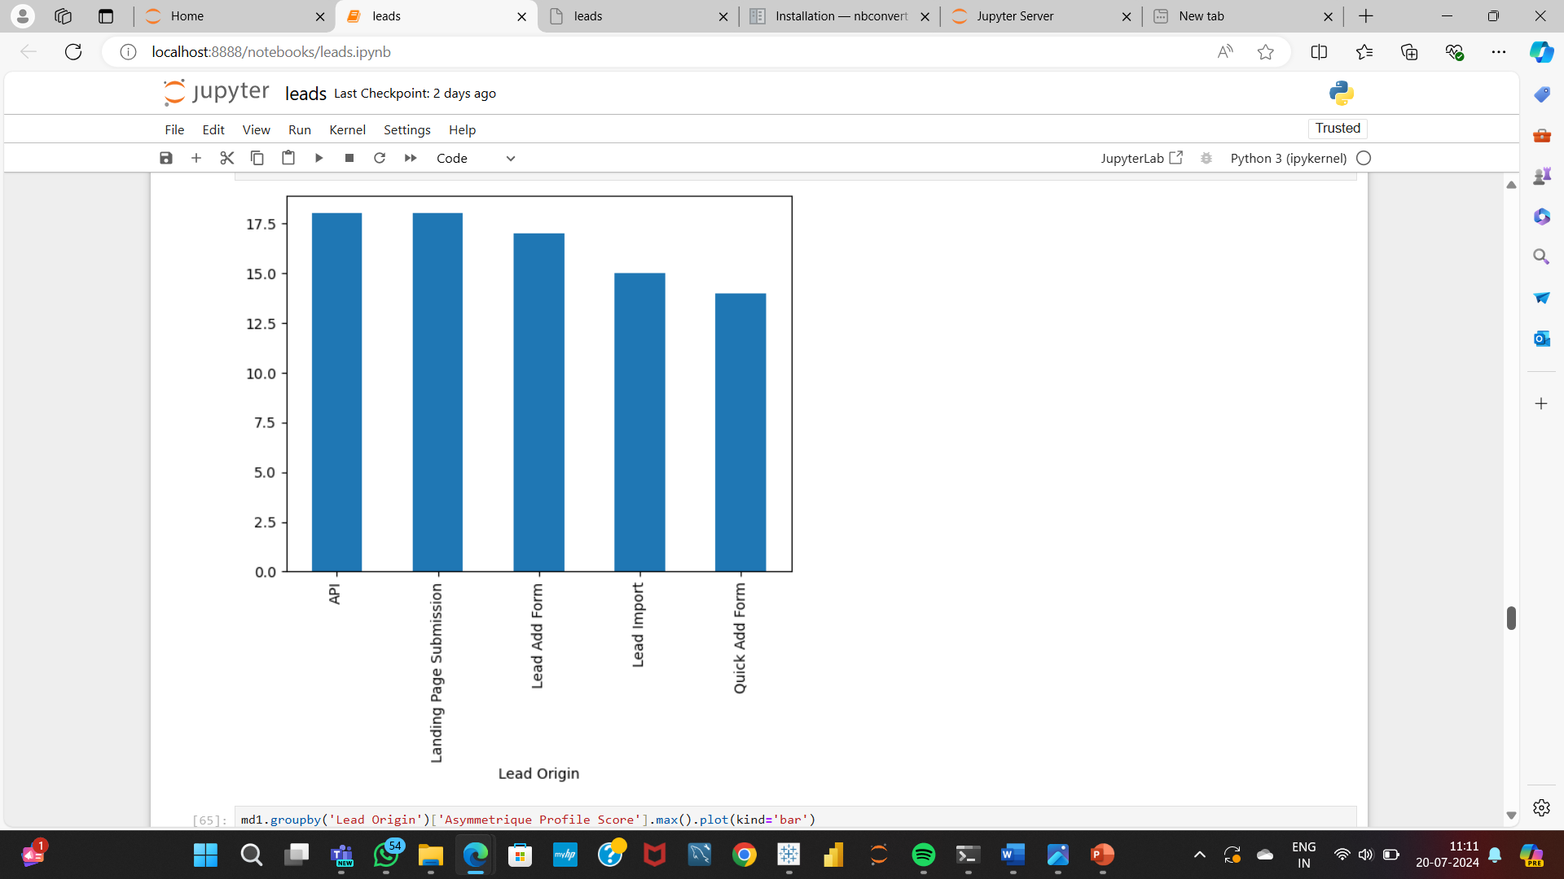
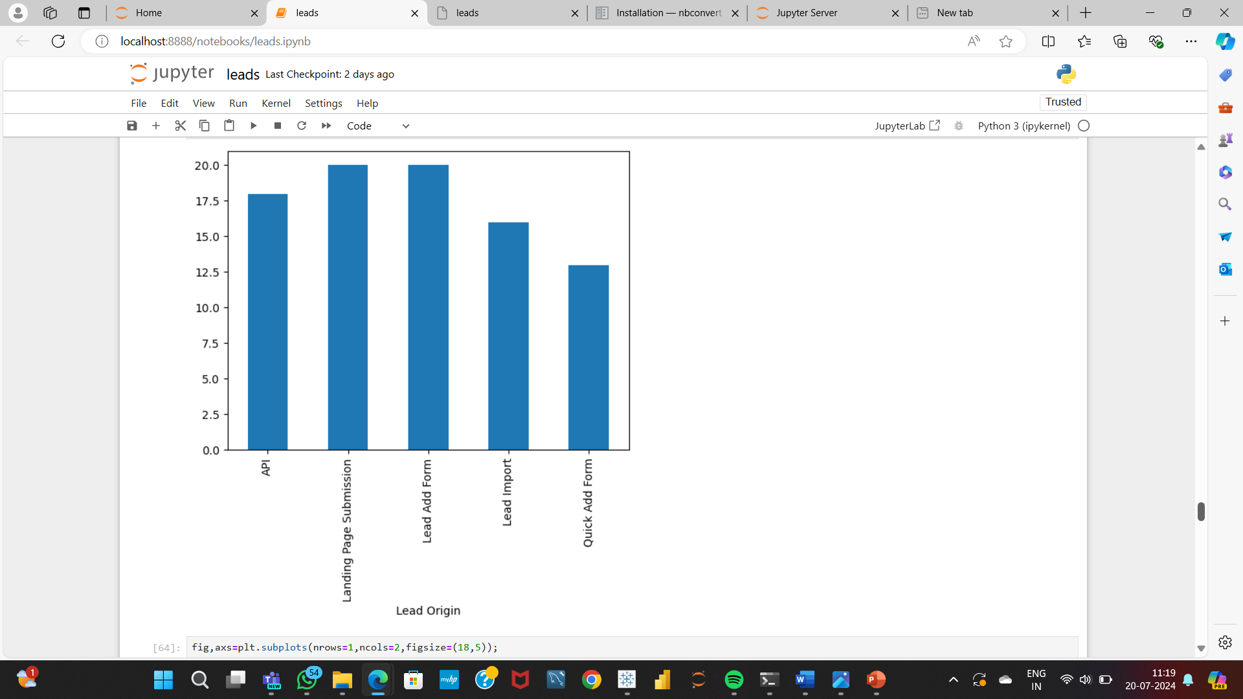
EDA Insight 6
This insight show the lead origins and their respective Asymmetrique activity score and Asymmetrique profile score
The maximum score can be obtained by grouping the lead origin, activity score and profile score
Asymmetrique Activity score
Asymmetrique Profile score

Slide 8
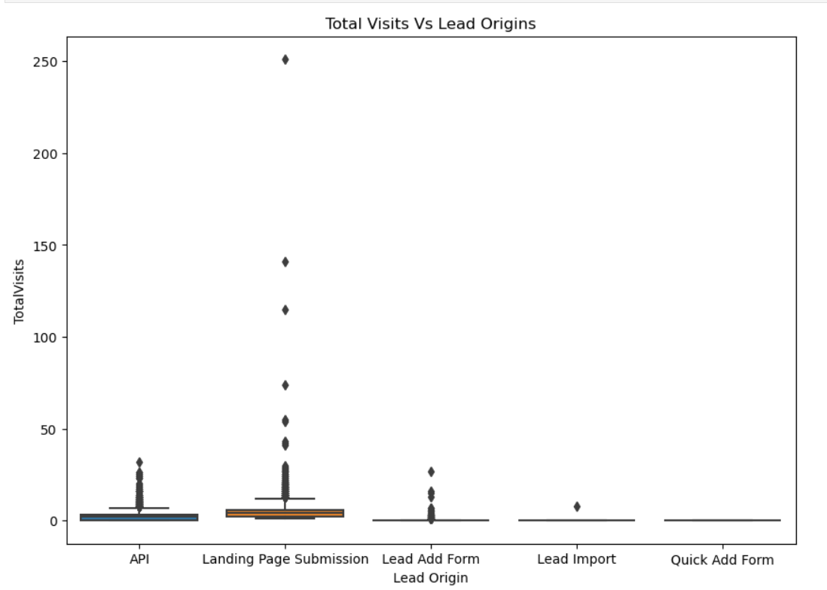
EDA Insight 7
This insight shows the lead origins through which the maximum number of total visits have been attained

Slide 9
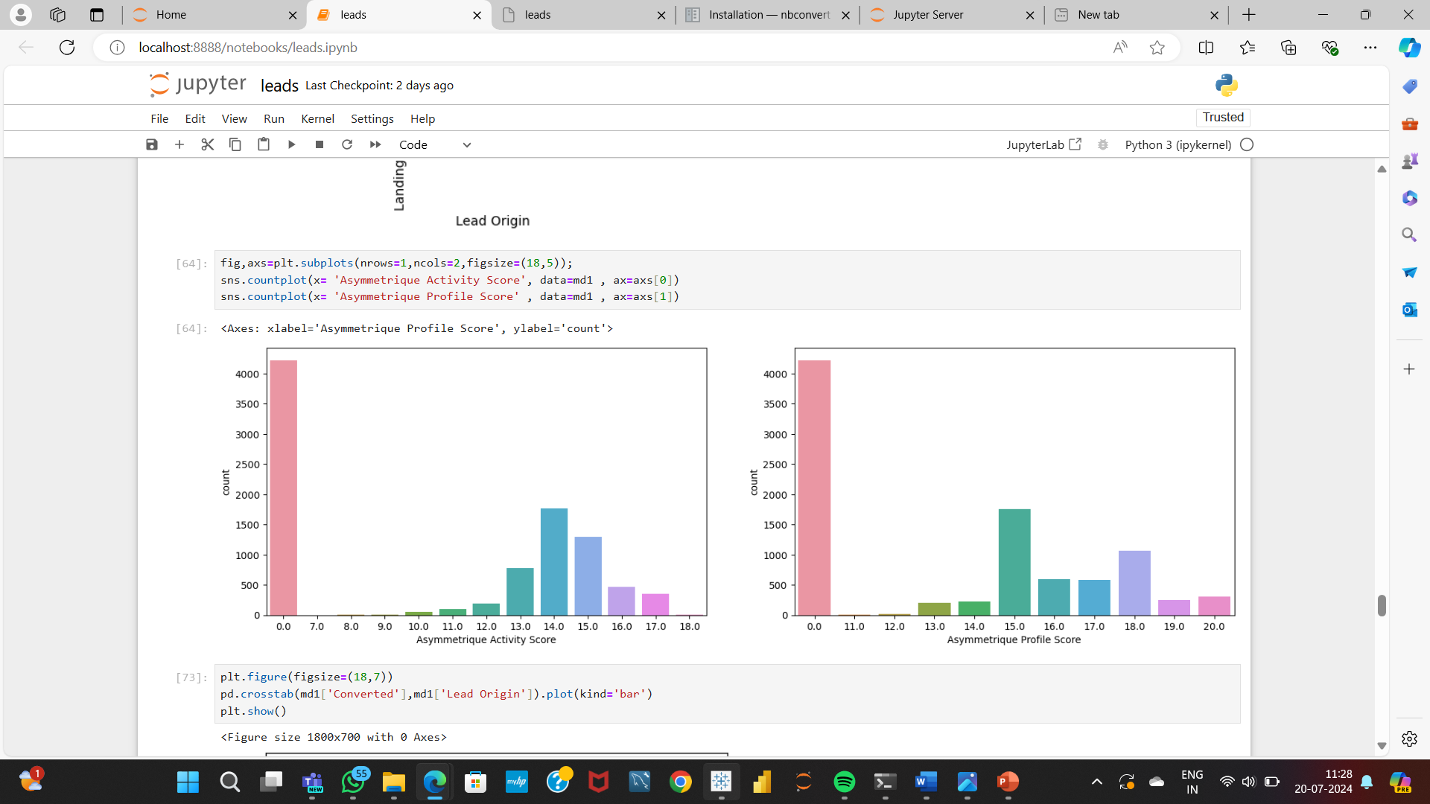
EDA Insight 8
This insight shows the count of both asymmetrique activity score and asymmetrique profile score

Slide 10
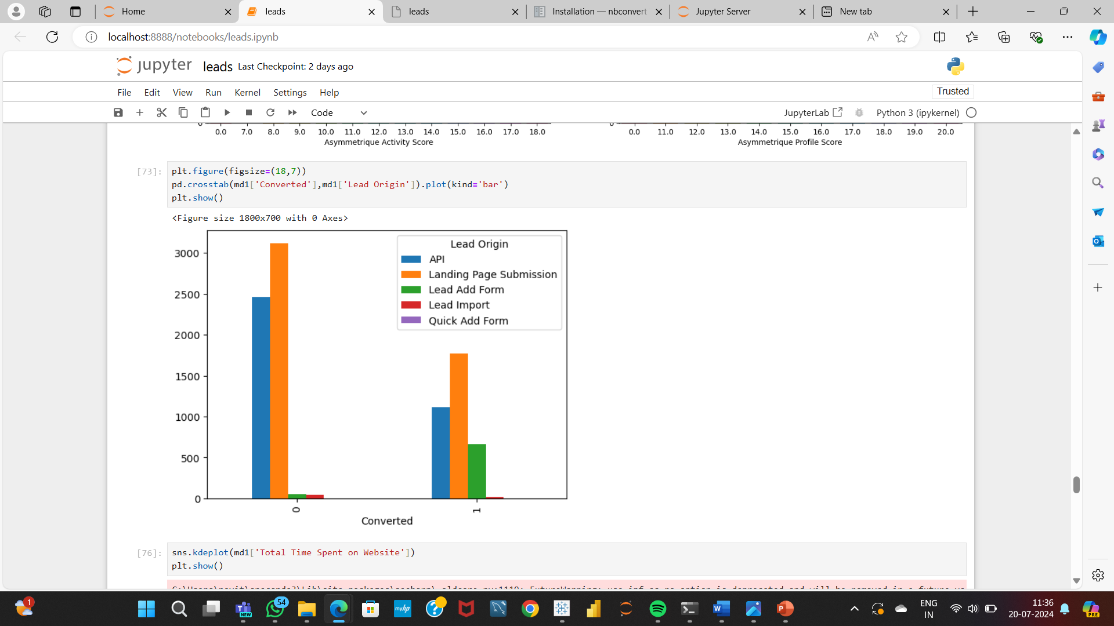
EDA Insight 9
This insight shows the count of conversion which has been successfully converted to either 0 or 1 with respect to lead origin

Slide 11
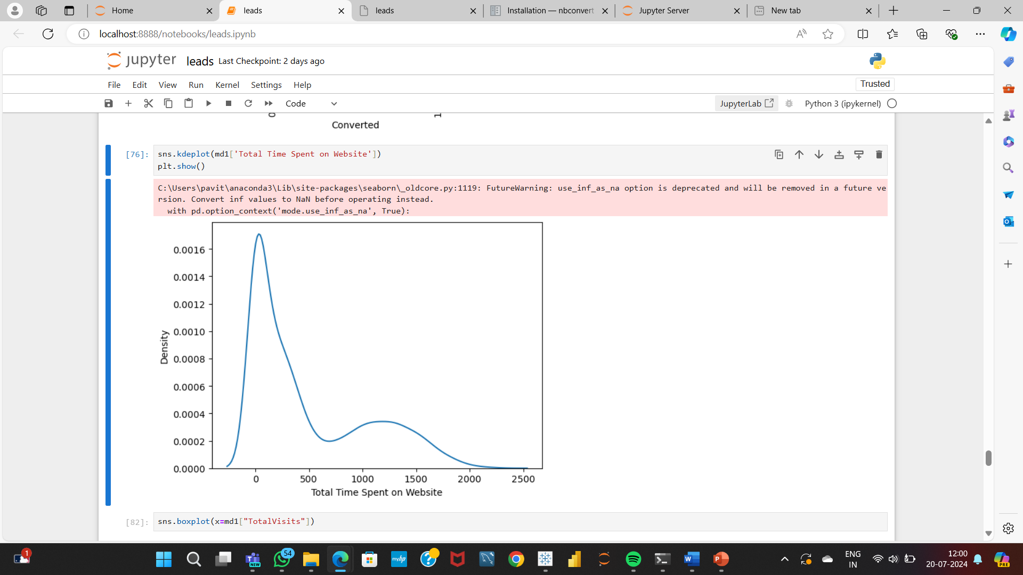
EDA Insight 10
This insight shows the density of the total time spent on the website

Slide 12
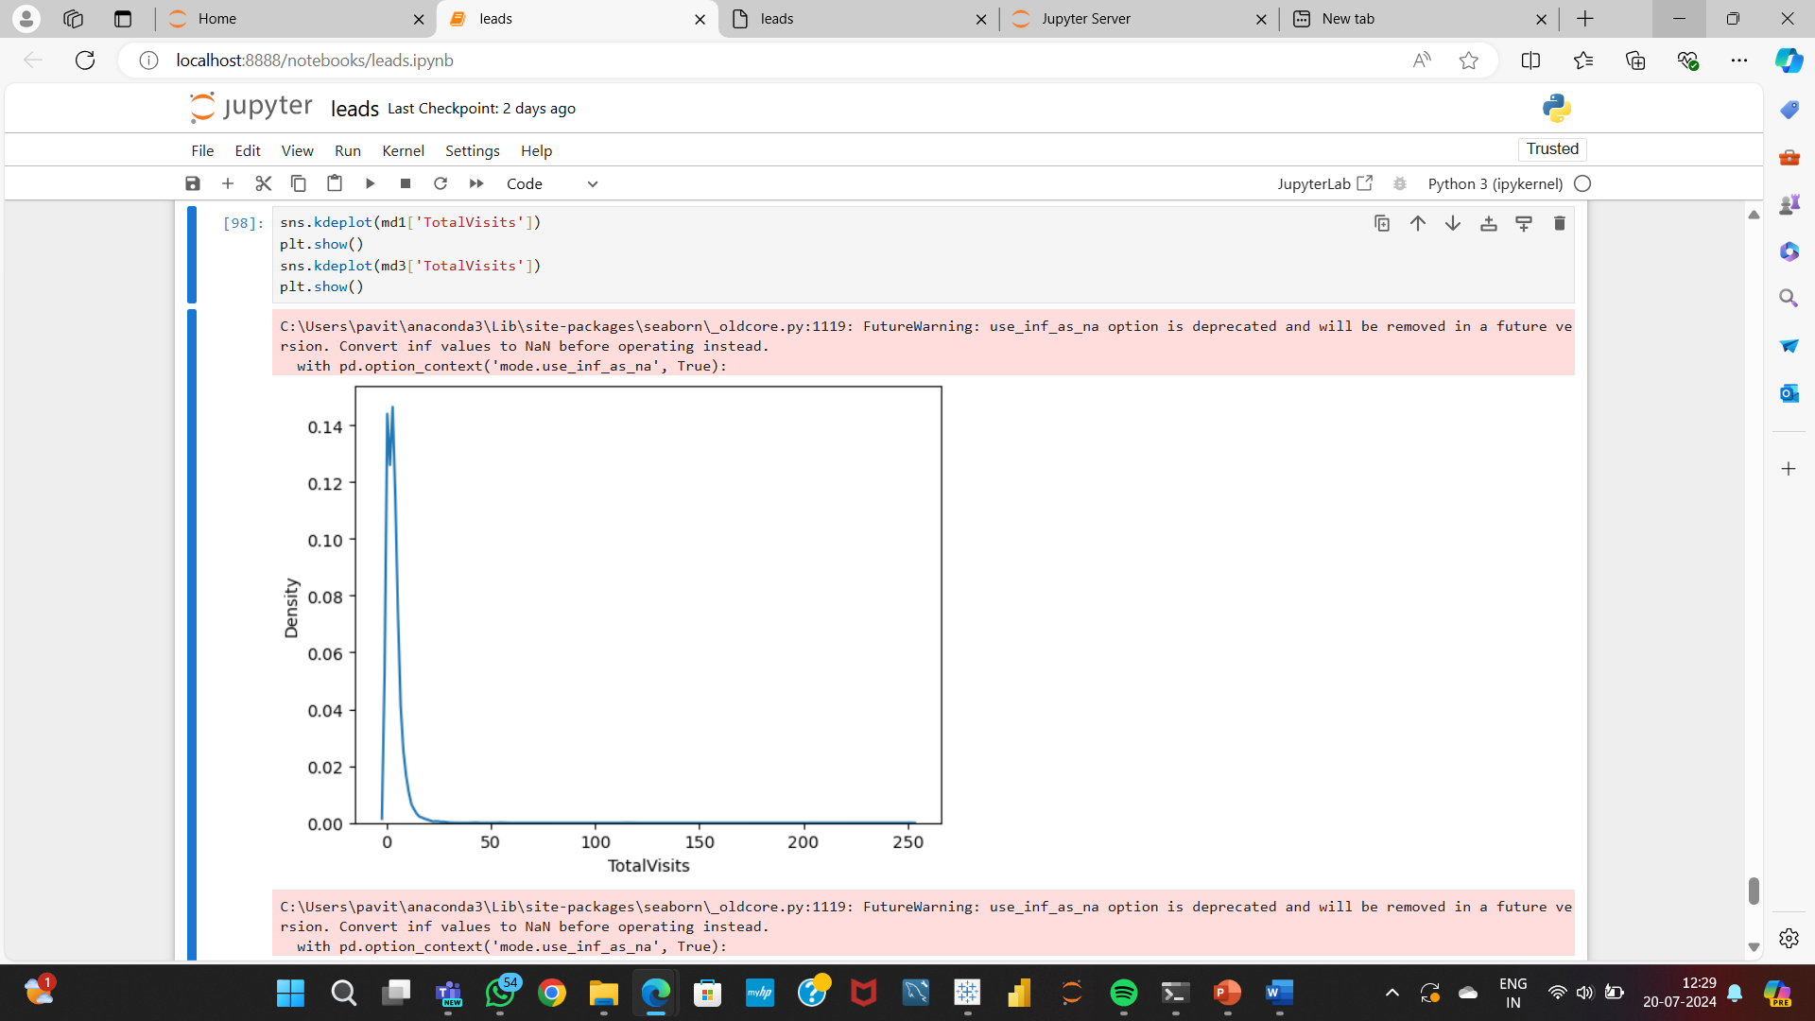
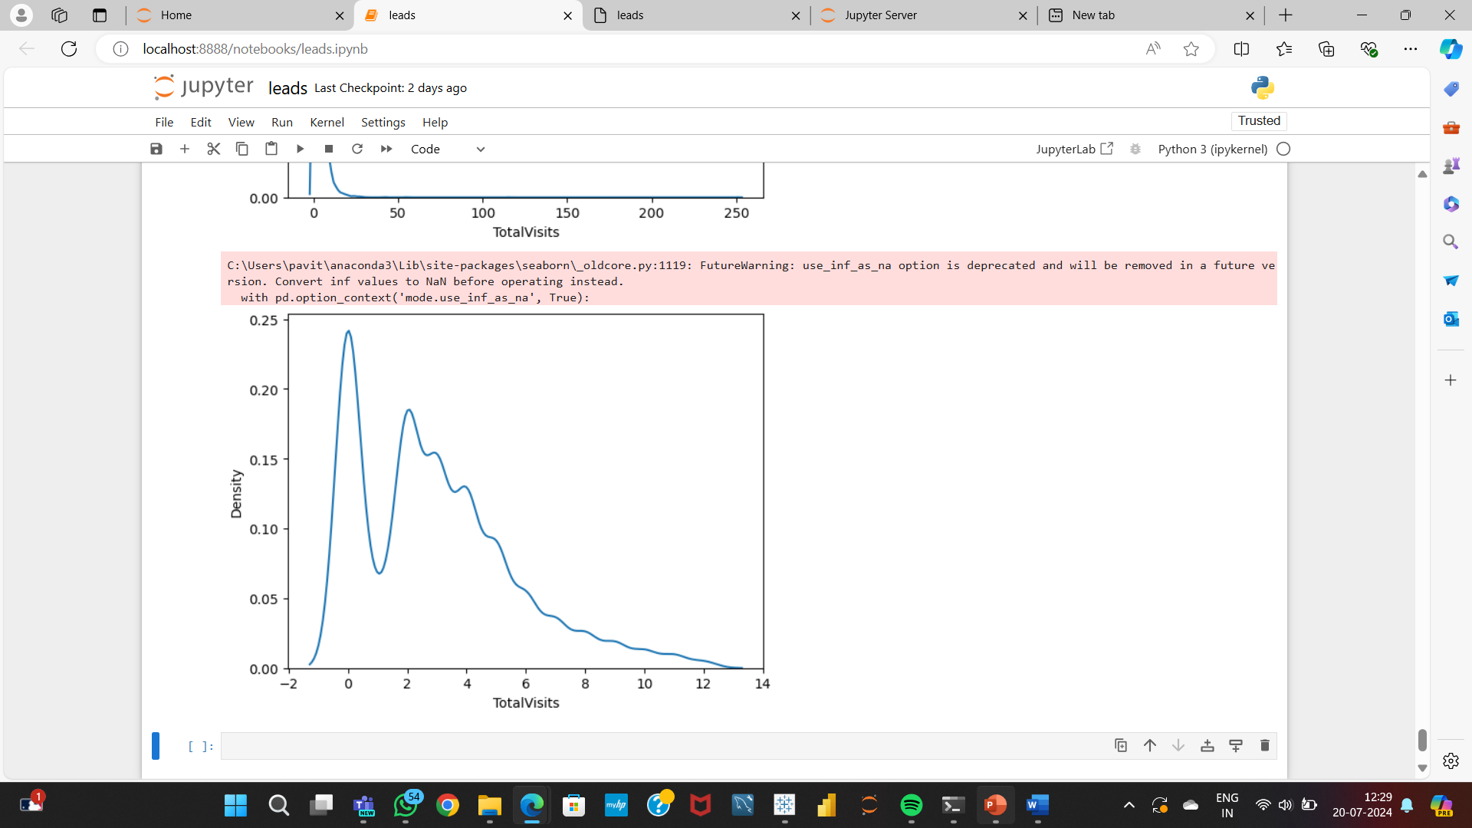
EDA Insight 11
This insights shows the values of total visits after performing the skewness and kurtosis.
The before treatment graph shows the general narrow peak
After treating it starts with slight negative skewness and ends in a positive side, likewise the kurtosis also shows the positive and normal peak.

Slide 13
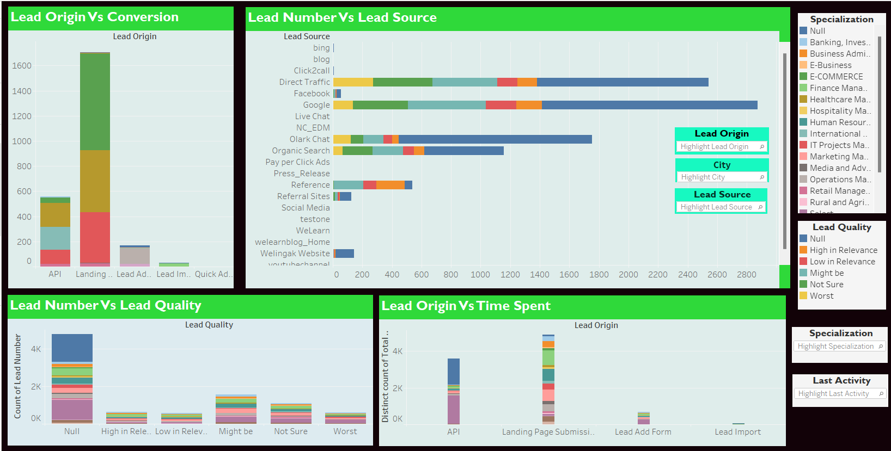
DASHBOARD 1

Slide 14
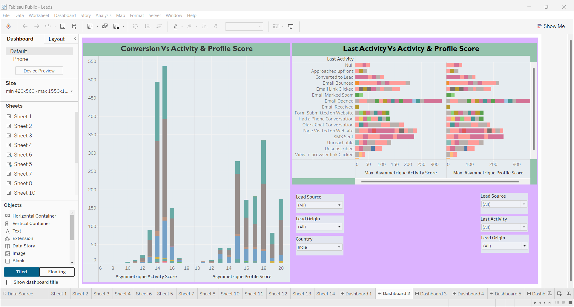
DASHBOARD 2

Slide 15
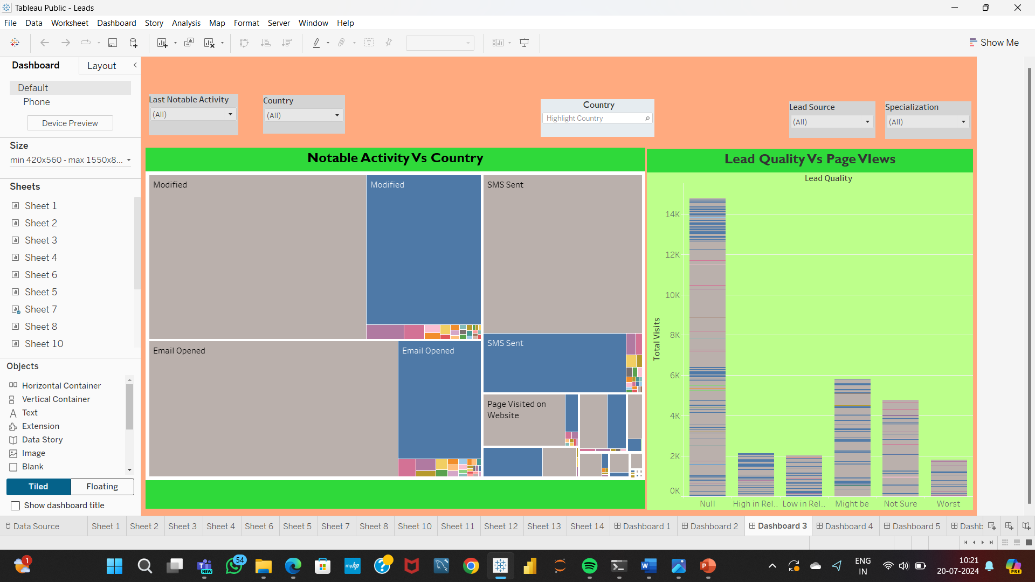
DASHBOARD 3

Slide 16
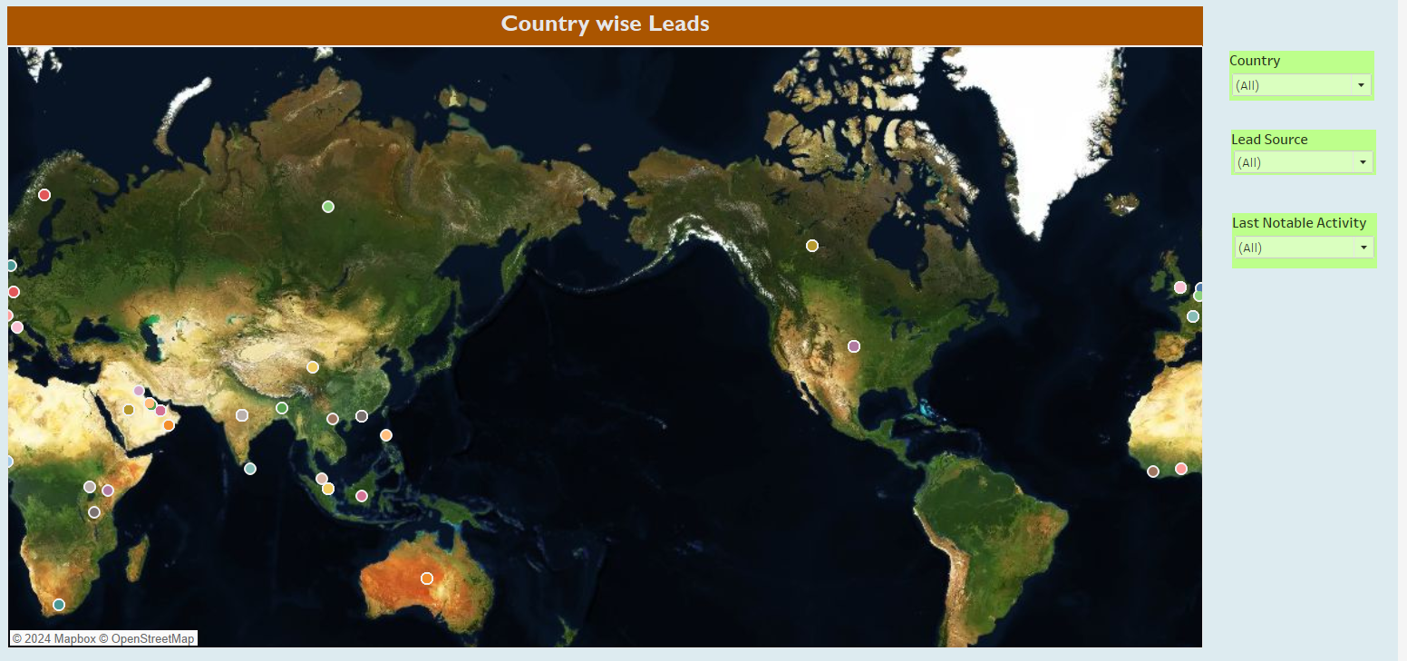
DASHBOARD 4

Slide 17
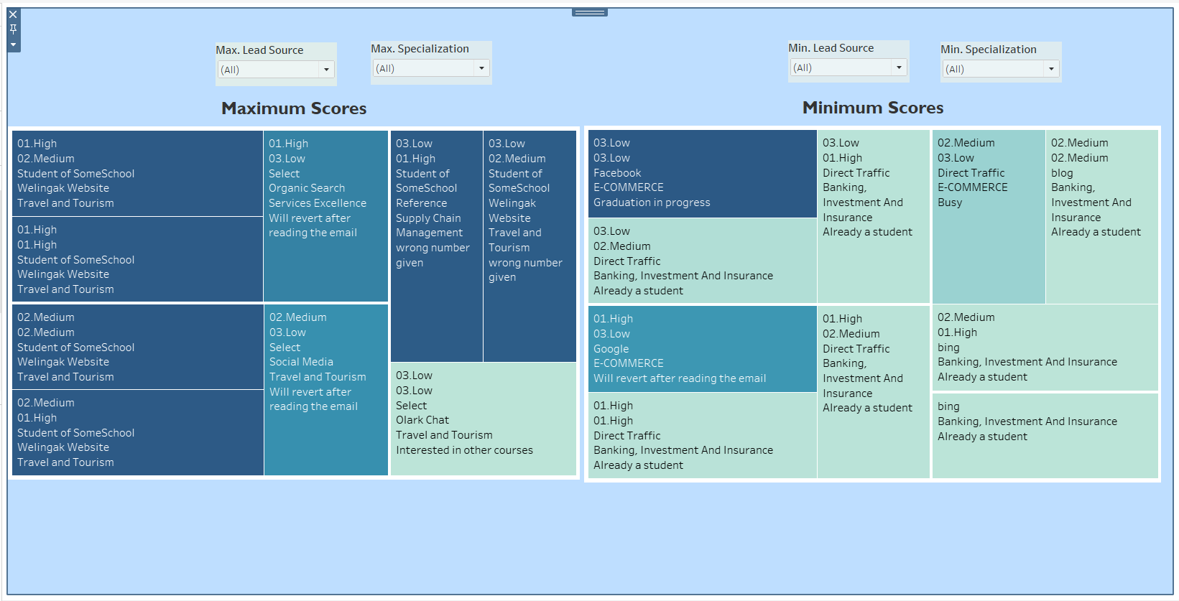
DASHBOARD 5

Slide 18
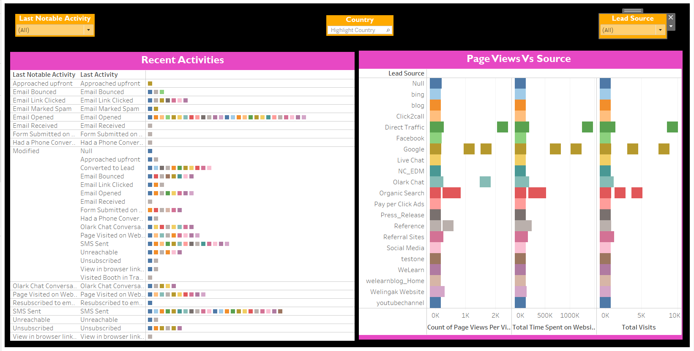
DASHBOARD 6

